Slide 1
COT5615: Math for Intelligent Systems I
Anand Rangarajan
Lecture 8

Slide 2
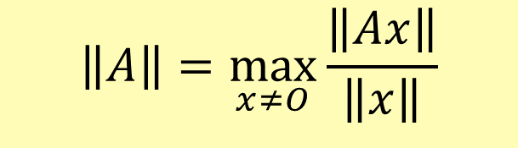
Existence, Uniqueness, and Conditioning
Solving Linear Systems Special Types of Linear Systems Software for Linear Systems
Singularity and Nonsingularity Norms
Condition Number Error Bounds
Matrix Norms
Matrix norm corresponding to given vector norm is defined by
$$\left\|A\right\|=\max_{x≠O}{\frac{\left\|Ax\right\|}{\left\|x\right\|}}$$
Norm of matrix measures maximum stretching matrix does to any vector in given vector norm

Slide 3
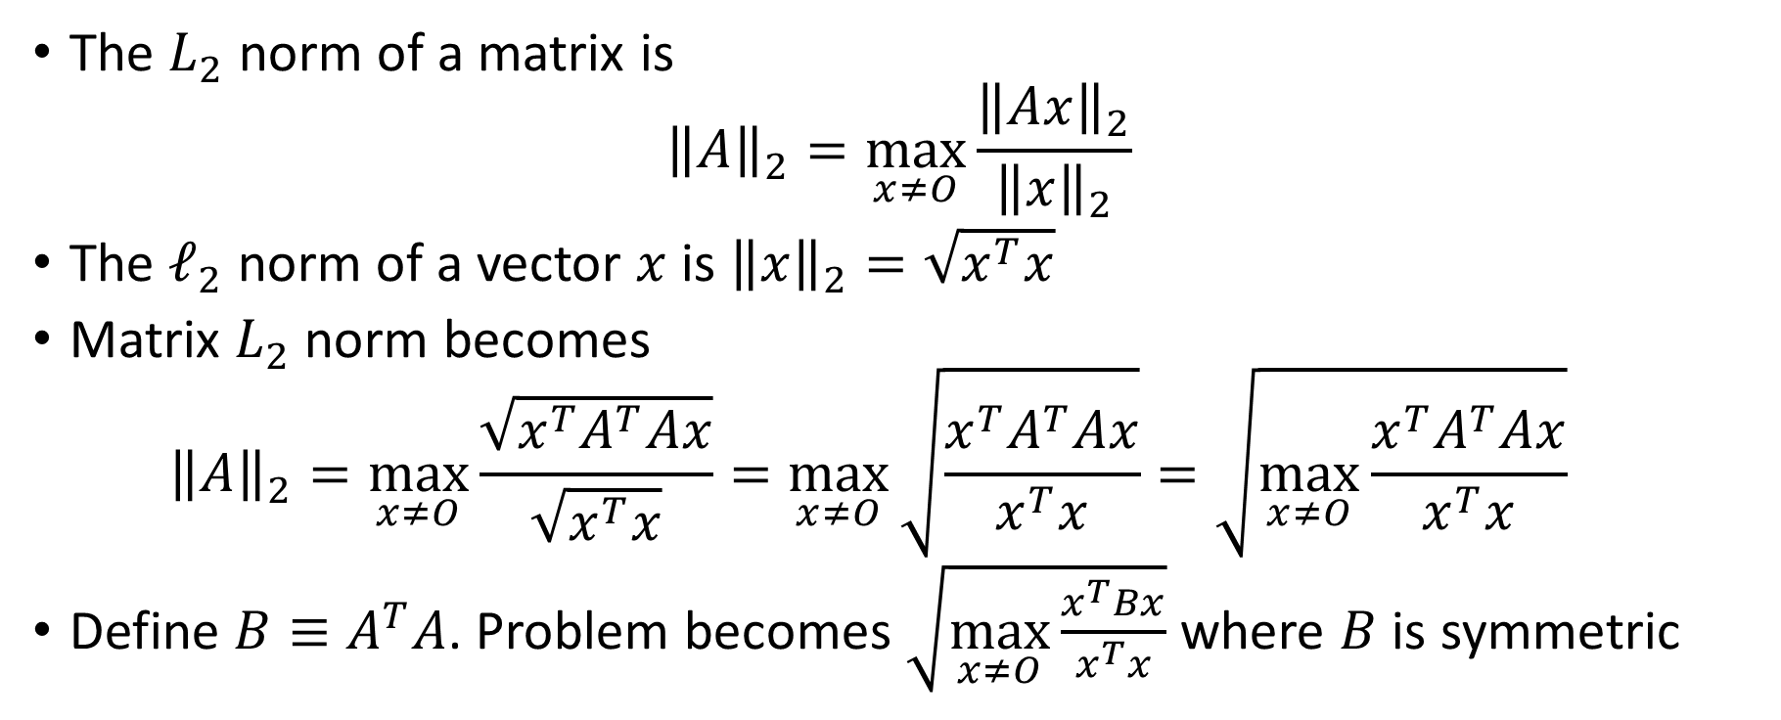

Matrix $L_{2}$ Norm
The $L_{2}$ norm of a matrix is
$${\left\|A\right\|}_{2}=\max_{x≠O}{\frac{{\left\|Ax\right\|}_{2}}{{\left\|x\right\|}_{2}}}$$
The $ℓ_{2}$ norm of a vector $x$ is ${\left\|x\right\|}_{2}=\sqrt{x^{T}x}$
Matrix $L_{2}$ norm becomes
$${\left\|A\right\|}_{2}=\max_{x≠O}{\frac{\sqrt{x^{T}A^{T}Ax}}{\sqrt{x^{T}x}}}=\max_{x≠O}{\sqrt{\frac{x^{T}A^{T}Ax}{x^{T}x}}=\sqrt{\max_{x≠O}\frac{x^{T}A^{T}Ax}{x^{T}x}}{}}$$
Define $B≡A^{T}A$. Problem becomes $\sqrt{\max_{x≠O}{\frac{x^{T}Bx}{x^{T}x}}}$ where $B$ is symmetric

Slide 4
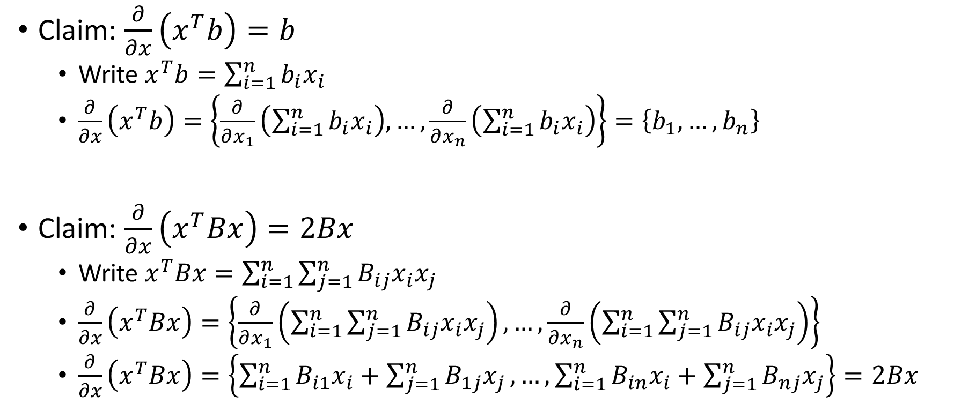
Derivatives of a scalar w.r.t. a vector
Claim: $\frac{∂}{∂x}\left(x^{T}b\right)=b$
Write $x^{T}b=\sum_{i=1}^{n}{b_{i}x_{i}}$
$\frac{∂}{∂x}\left(x^{T}b\right)=\left\{\frac{∂}{∂x_{1}}\left(\sum_{i=1}^{n}{b_{i}x_{i}}\right),…,\frac{∂}{∂x_{n}}\left(\sum_{i=1}^{n}{b_{i}x_{i}}\right)\right\}=\left\{b_{1},…,b_{n}\right\}$
Claim: $\frac{∂}{∂x}\left(x^{T}Bx\right)=2Bx$
Write $x^{T}Bx=\sum_{i=1}^{n}{\sum_{j=1}^{n}{B_{ij}x_{i}x_{j}}}$
$\frac{∂}{∂x}\left(x^{T}Bx\right)=\left\{\frac{∂}{∂x_{1}}\left(\sum_{i=1}^{n}{\sum_{j=1}^{n}{B_{ij}x_{i}x_{j}}}\right),…,\frac{∂}{∂x_{n}}\left(\sum_{i=1}^{n}{\sum_{j=1}^{n}{B_{ij}x_{i}x_{j}}}\right)\right\}$
$\frac{∂}{∂x}\left(x^{T}Bx\right)=\left\{\sum_{i=1}^{n}{B_{i1}x_{i}}+\sum_{j=1}^{n}{B_{1j}x_{j}},…,\sum_{i=1}^{n}{B_{in}x_{i}}+\sum_{j=1}^{n}{B_{nj}x_{j}}\right\}=2Bx$

Slide 5
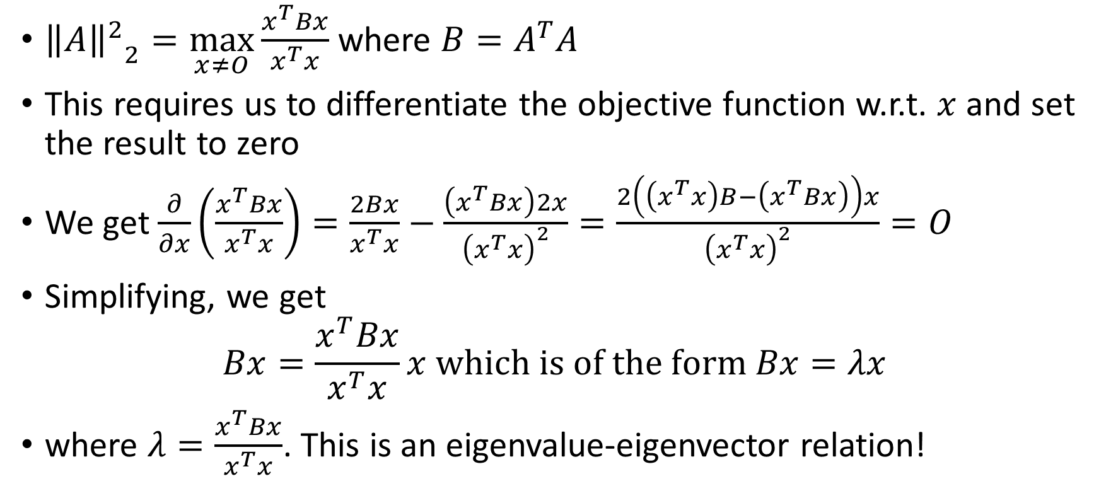

Back to Matrix $L_{2}$ Norm
${{\left\|A\right\|}^{2}}_{2}=\max_{x≠O}{\frac{x^{T}Bx}{x^{T}x}}$ where $B=A^{T}A$
This requires us to differentiate the objective function w.r.t. $x$ and set the result to zero
We get $\frac{∂}{∂x}\left(\frac{x^{T}Bx}{x^{T}x}\right)=\frac{2Bx}{x^{T}x}−\frac{\left(x^{T}Bx\right)2x}{{\left(x^{T}x\right)}^{2}}=\frac{2\left(\left(x^{T}x\right)B−\left(x^{T}Bx\right)\right)x}{{\left(x^{T}x\right)}^{2}}=O$
Simplifying, we get
$$Bx=\frac{x^{T}Bx}{x^{T}x}x which is of the form Bx=λx$$
where $λ=\frac{x^{T}Bx}{x^{T}x}$. This is an eigenvalue-eigenvector relation!

Slide 6
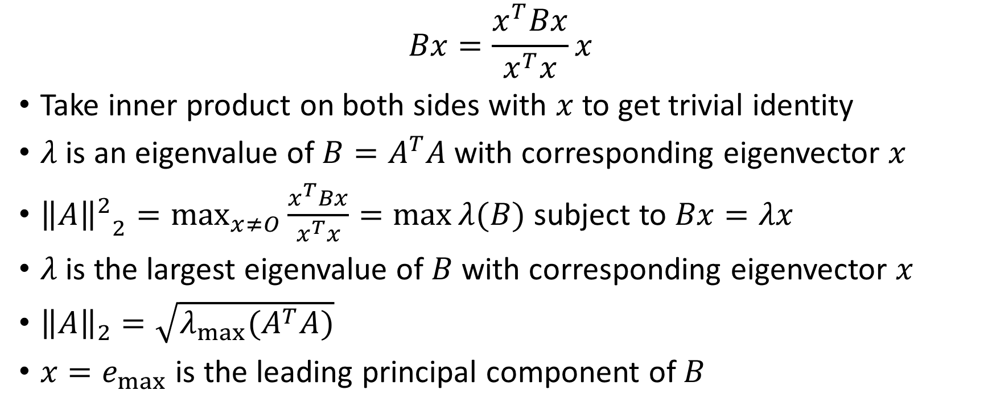

Principal Component and $L_{2}$ Norm
$$Bx=\frac{x^{T}Bx}{x^{T}x}x$$
Take inner product on both sides with $x$ to get trivial identity
$λ$ is an eigenvalue of $B=A^{T}A$ with corresponding eigenvector $x$
${{\left\|A\right\|}^{2}}_{2}=\max_{x≠O}{\frac{x^{T}Bx}{x^{T}x}=\max{λ(B)}}$ subject to $Bx=λx$
$λ$ is the largest eigenvalue of $B$ with corresponding eigenvector $x$
${\left\|A\right\|}_{2}=\sqrt{λ_{max}(A^{T}A)}$
$x=e_{max}$ is the leading principal component of $B$

Slide 7
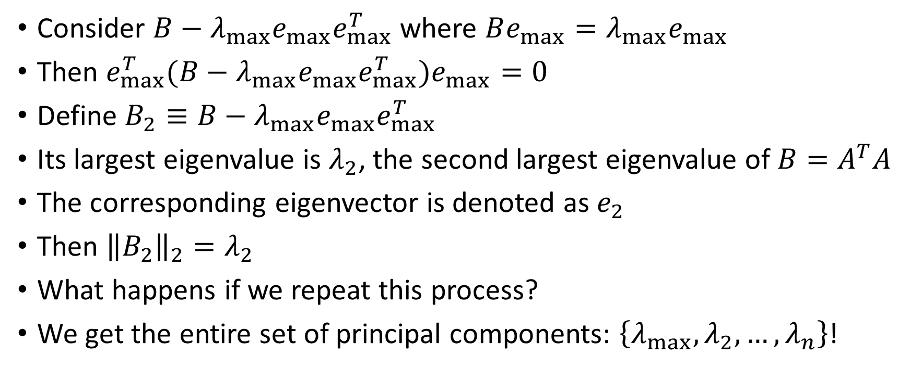
Principal Components revisited
Consider $B−λ_{max}e_{max}e_{max}^{T}$ where $Be_{max}=λ_{max}e_{max}$
Then $e_{max}^{T}(B−λ_{max}e_{max}e_{max}^{T})e_{max}=0$
Define $B_{2}≡B−λ_{max}e_{max}e_{max}^{T}$
Its largest eigenvalue is $λ_{2}$, the second largest eigenvalue of $B=A^{T}A$
The corresponding eigenvector is denoted as $e_{2}$
Then ${\left\|B_{2}\right\|}_{2}=λ_{2}$
What happens if we repeat this process?
We get the entire set of principal components: $\left\{λ_{max},λ_{2},…,λ_{n}\right\}$!
Notes:
When we are subtracting the lambda(max)e(max)e(max)` then basically we are removing the principal component from the matrix, and what is left is the n-1 remaining components. So basically when I will hit the matrix the new matrix with e(max) then I will get 0. That means e(max) will be in the null space of that metrix. When the metrix becomes 0 that means all the components are removed.

Slide 8
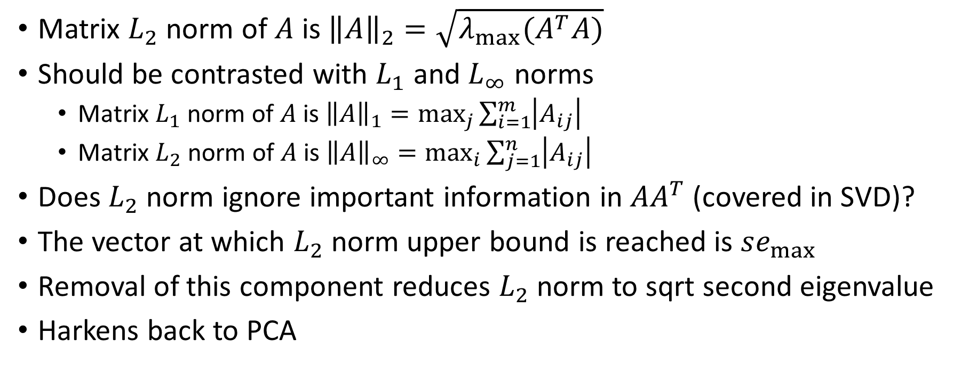
Summary
Matrix $L_{2}$ norm of $A$ is ${\left\|A\right\|}_{2}=\sqrt{λ_{max}(A^{T}A)}$
Should be contrasted with $L_{1}$ and $L_{∞}$ norms
Matrix $L_{1}$ norm of $A$ is ${\left\|A\right\|}_{1}=\max_{j}{\sum_{i=1}^{m}{\left|A_{ij}\right|}}$
Matrix $L_{2}$ norm of $A$ is ${\left\|A\right\|}_{∞}=\max_{i}{\sum_{j=1}^{n}{\left|A_{ij}\right|}}$
Does $L_{2}$ norm ignore important information in $AA^{T}$ (covered in SVD)?
The vector at which $L_{2}$ norm upper bound is reached is $se_{max}$
Removal of this component reduces $L_{2}$ norm to sqrt second eigenvalue
Harkens back to PCA

